Slide 1
Statistics 367-1-4361 MCMC
Opher Donchin

Slide 2
5A Review

Slide 3
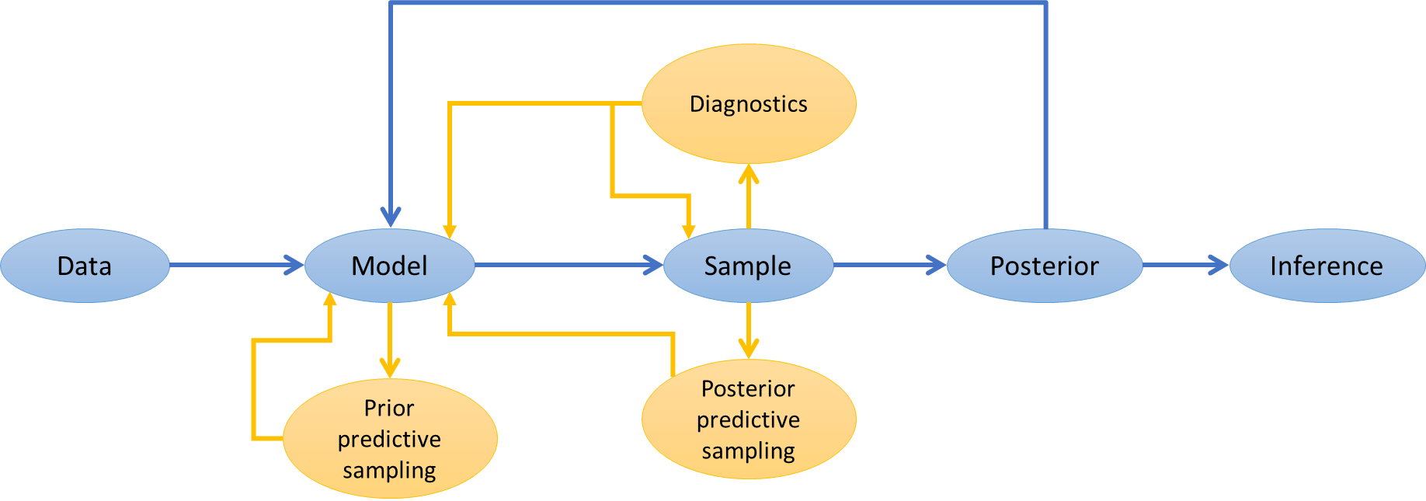
Bayesian workflow
Bayesian workflow guides data analysis from start to finish.
Each step influences modeling decisions and inference.
Each step has its own tools n

Slide 4
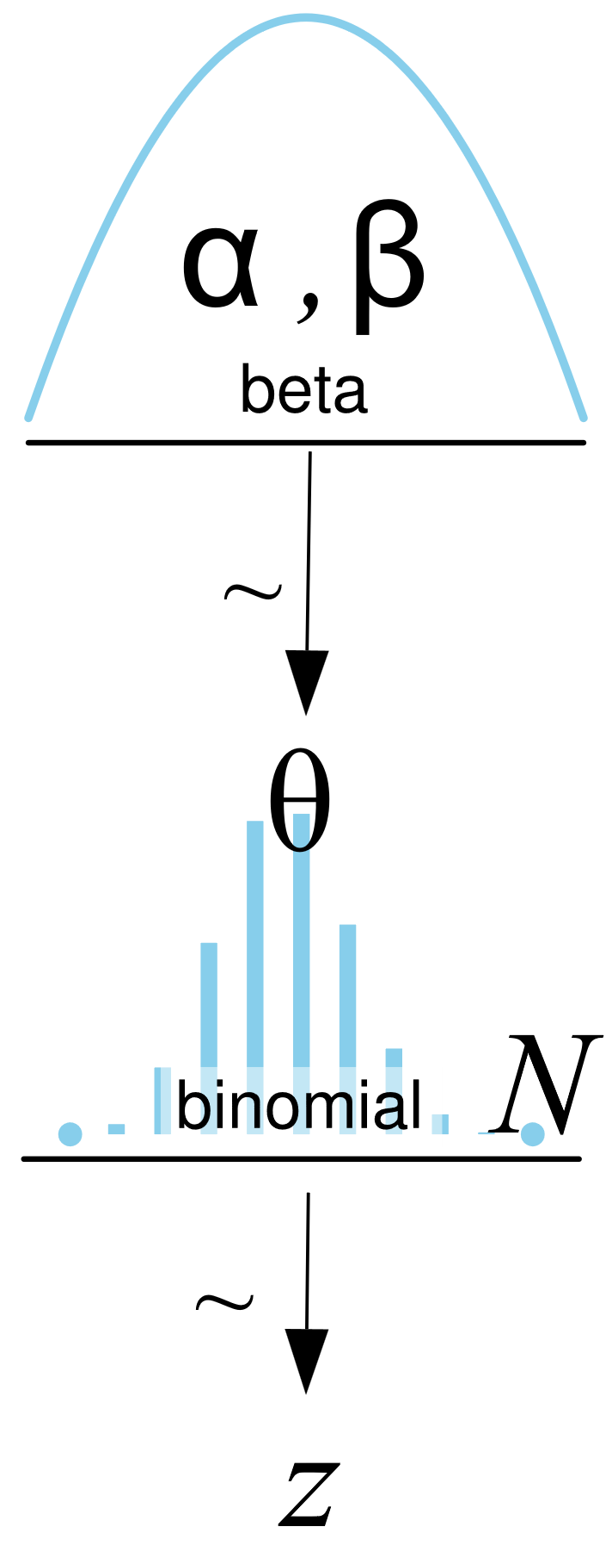
Models
Can write the model with equations or pictures

Slide 5
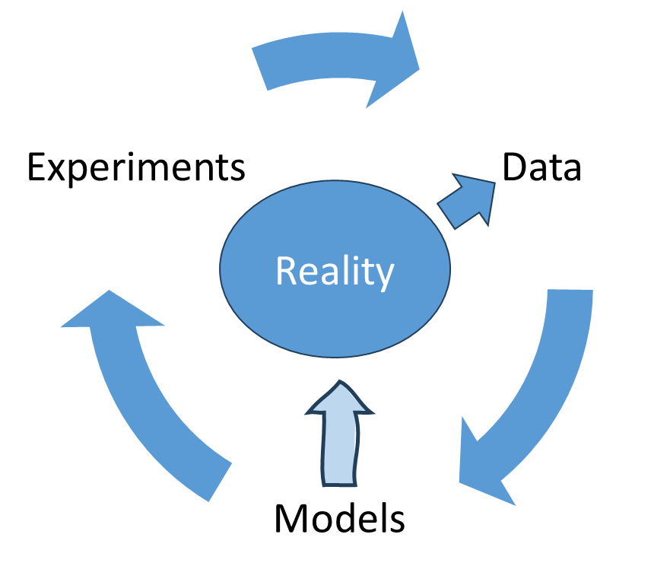
Baye’s rule updates models

Slide 6
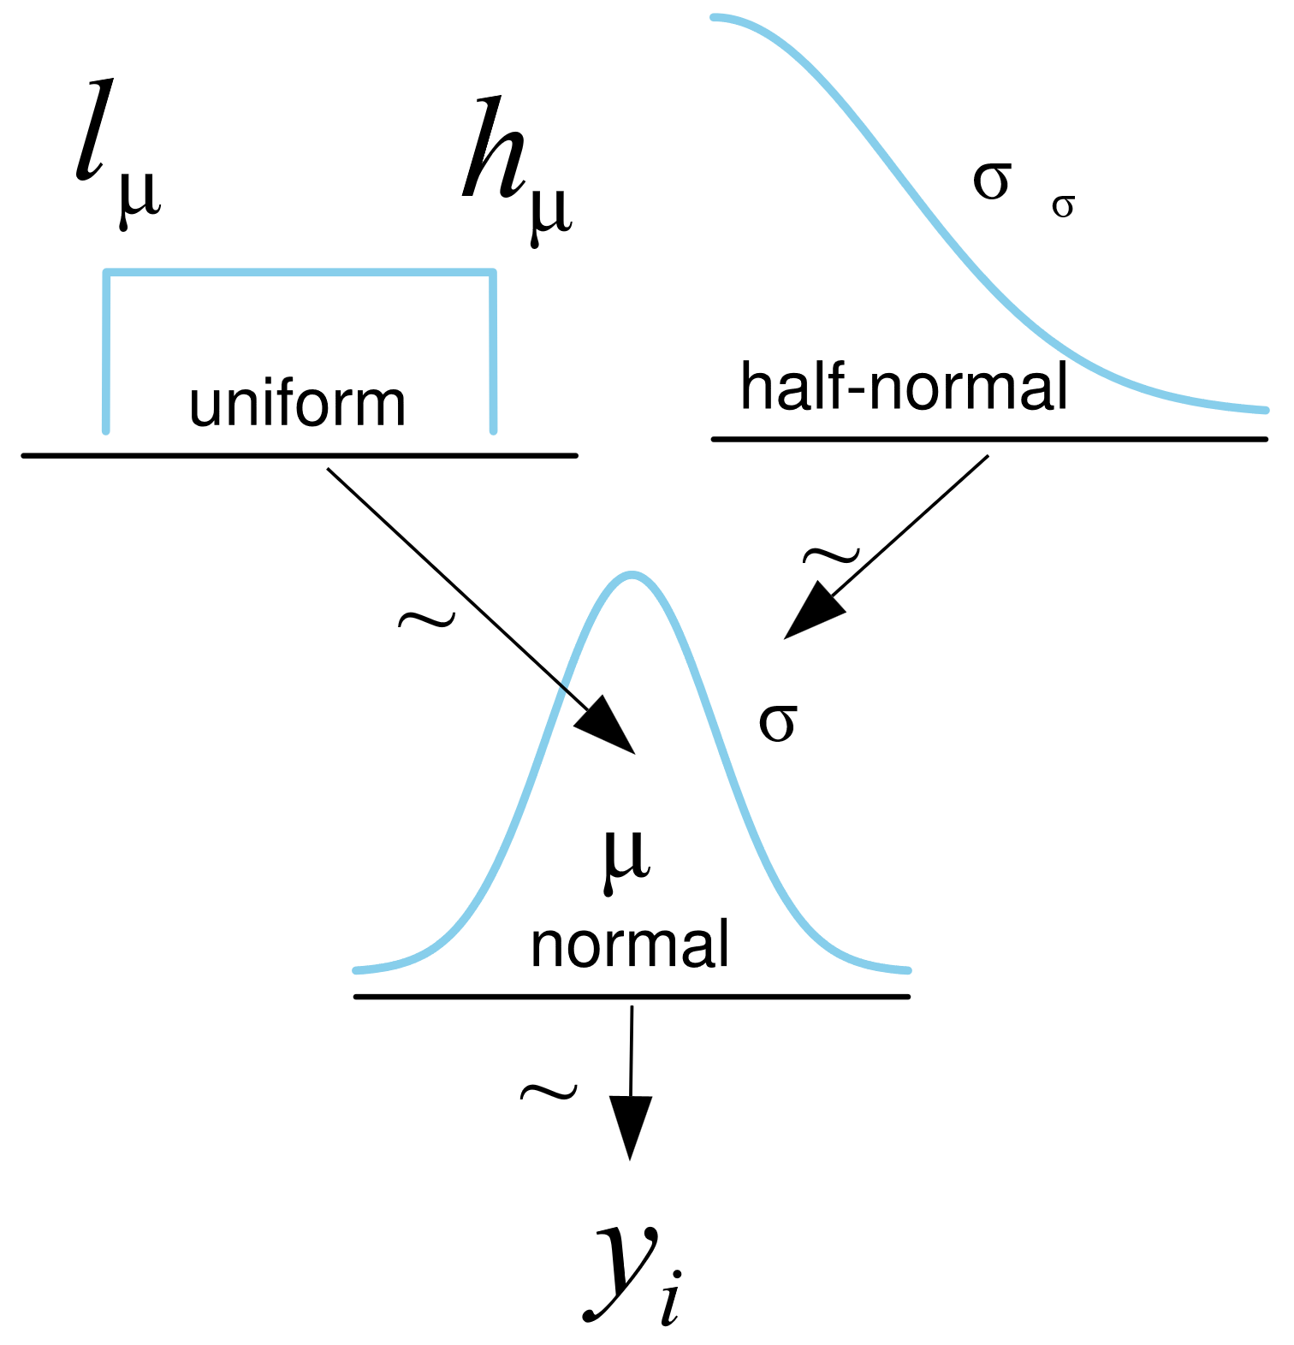
Gaussians are multi-parameter
Each parameter has a prior distribution

Slide 7
Sample from the posterior
l_mu = 40
h_mu = 70
σ_σ = 5
with pm.Model() as model_g:
μ = pm.Uniform('μ', lower=l_mu, upper=h_mu)
σ = pm.HalfNormal('σ', sigma=σ_σ)
y = pm.Normal('y', mu=μ, sigma=σ, observed=data)
idata_g = pm.sample(random_seed=4591, model=model_g)
with model_g:
idata_g.extend(pm.sample(random_seed=4591), join='right')

Slide 8
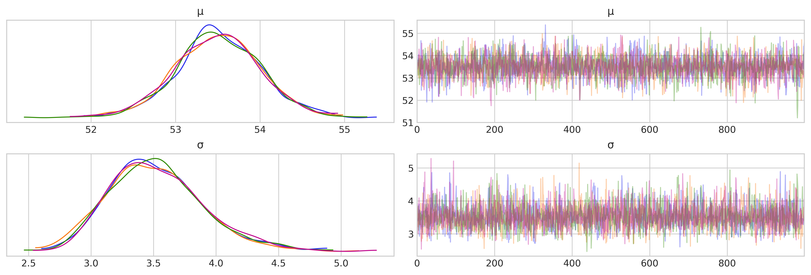
Trace plots are a first diagnostic
See:
Mixing of chains
Overlap of posteriors
Shape of posteriors

Slide 9
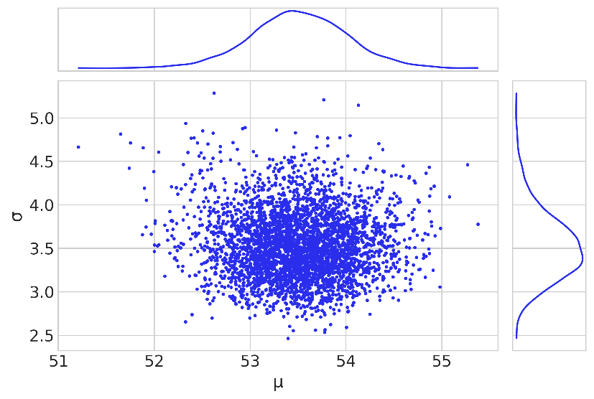
Every sample has both parameters

Slide 10
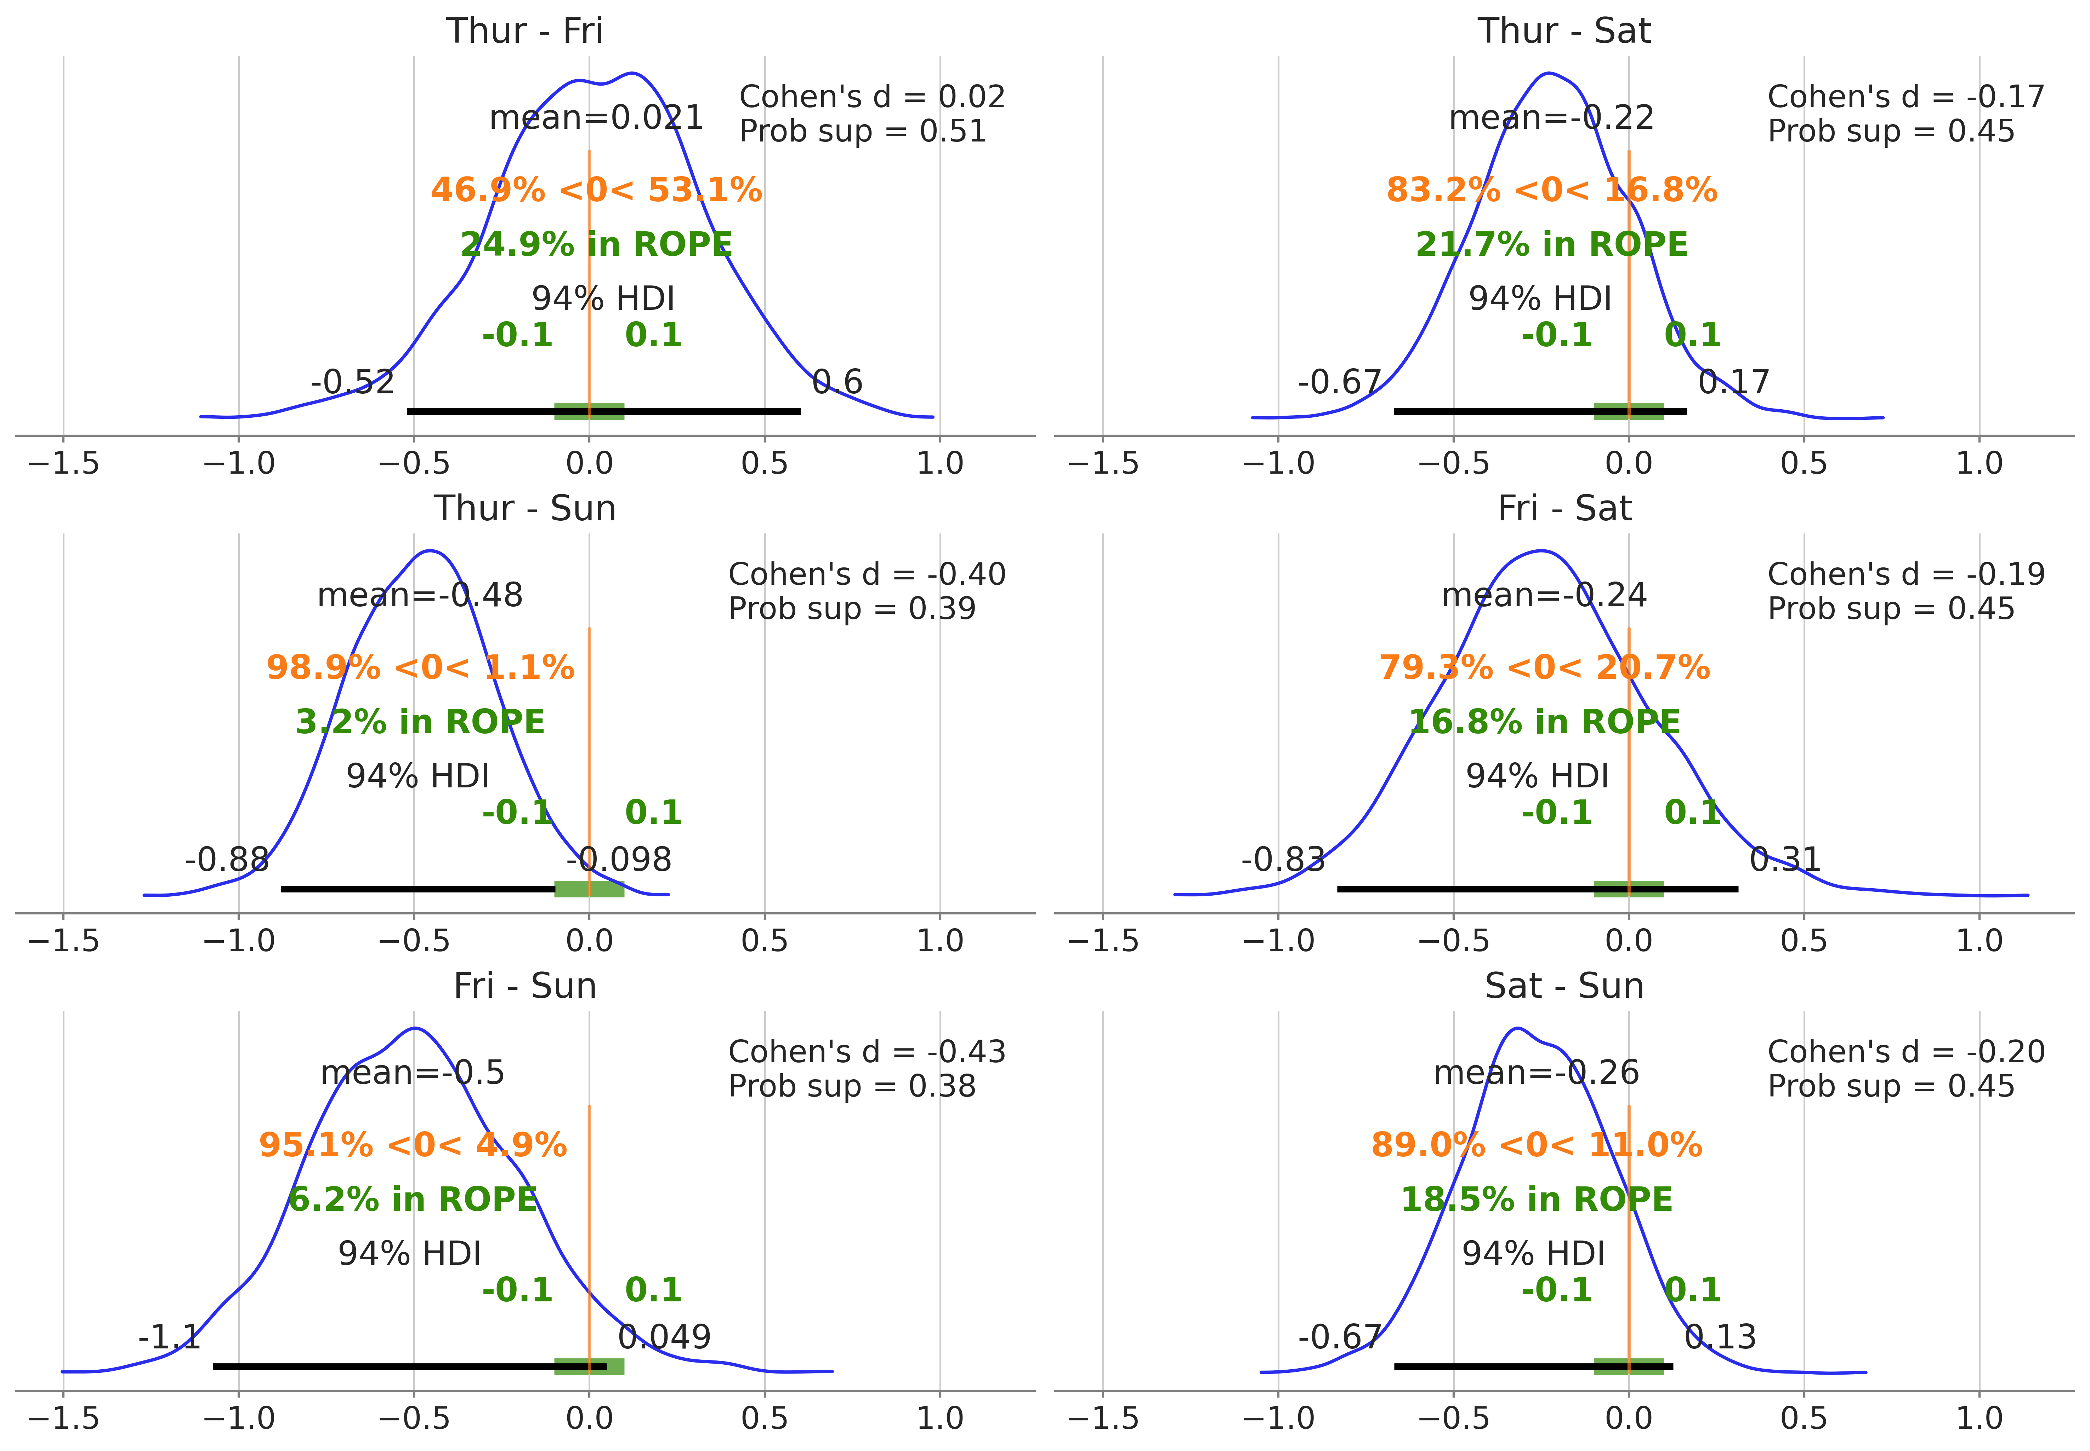

Slide 11
5B Automatic inference

Slide 12
Bayesian workflow
Diagnostics
Data
Model
Sample
Posterior
Inference
Posterior predictive sampling
Prior predictive sampling

Slide 13
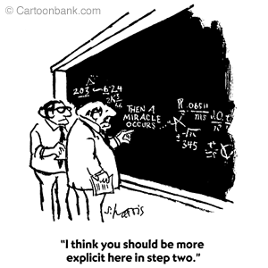
What does automatic inference do
Start with a model and data
Call “sample”
Get samples
How does that work?
How can you go from a model and data to samples?

Slide 14
The history of Bayesian inference
Analytic solutions
Only worked for a few problems
Computers make things faster
Works for more problems
MCMC algorithms
Works for many problems
HMC algorithms
Works much more quickly and reliably
It really is a miracle!
But how does it work?

Slide 15
5C Grid computing

Slide 16
The grid method
“Sample” at fixed intervals
Posterior is just prior times likelihood
And these are both easy to calculate
def posterior_grid(grid_points=50, heads=6, tails=9):
"""
A grid implementation for the coin-flipping problem
"""
grid = np.linspace(0, 1, grid_points)
prior = np.repeat(1/grid_points, grid_points) # uniform prior
likelihood = pz.Binomial(n=heads+tails, p=grid).pdf(heads)
posterior = likelihood * prior
posterior /= posterior.sum() * (1/grid_points)
return grid, posterior

Slide 17
Calculate first, normalize later
Normalizing is easy after you have the samples
def posterior_grid(grid_points=50, heads=6, tails=9):
"""
A grid implementation for the coin-flipping problem
"""
grid = np.linspace(0, 1, grid_points)
prior = np.repeat(1/grid_points, grid_points) # uniform prior
likelihood = pz.Binomial(n=heads+tails, p=grid).pdf(heads)
posterior = likelihood * prior
posterior /= posterior.sum() * (1/grid_points)
return grid, posterior

Slide 18
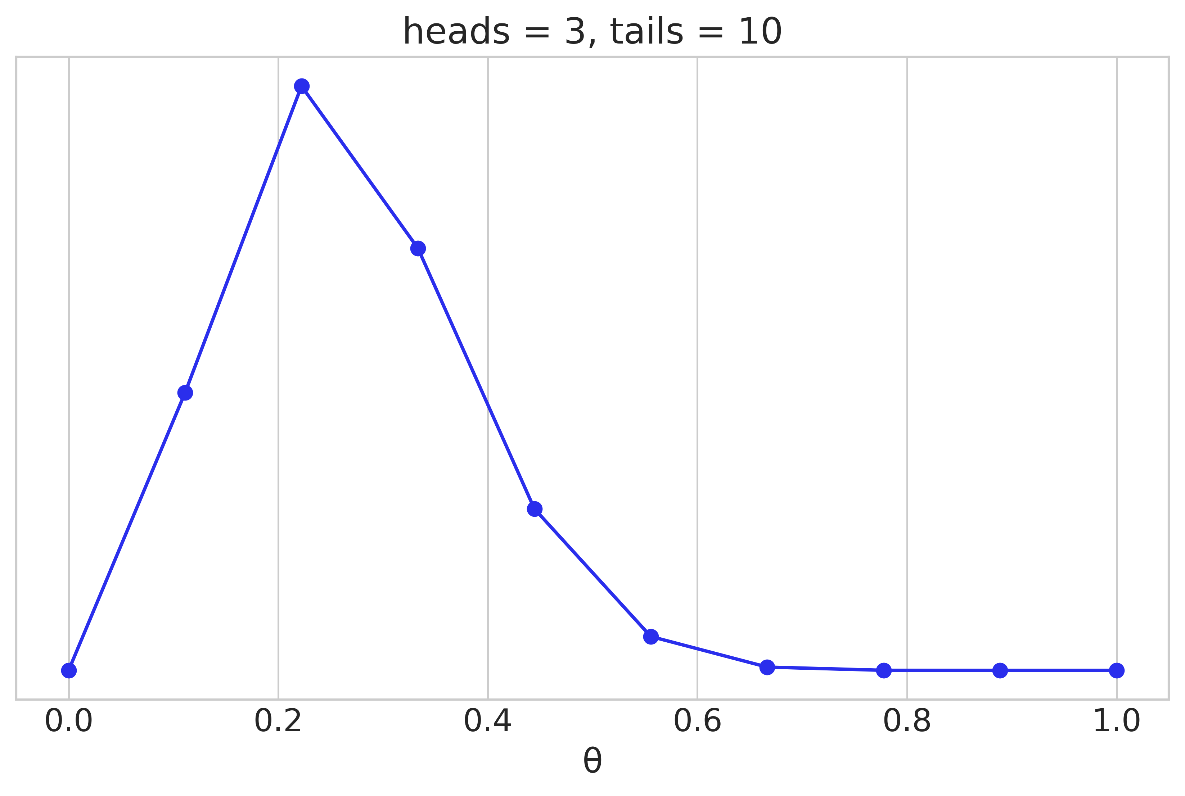

The posterior estimated with a grid
For $θ>0.7$, we are wasting calculation time on empty space
data = np.repeat([0, 1], (10, 3))
points = 10
h = data.sum()
t = len(data) - h
grid, posterior = posterior_grid(points, h, t)
plt.plot(grid, posterior, 'o-')

Slide 19
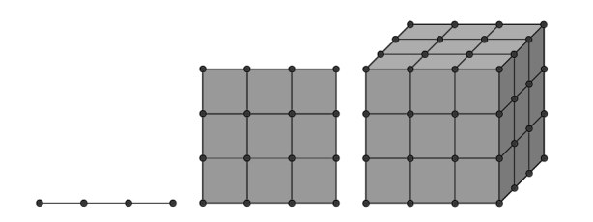
Limitations of grid computation
No focus on high probability areas
Curse of dimensionality
1 parameter: 100 samples
2 parameters: 1,000 samples
3 parameters: 100,000 samples
Real models can have 10s, 100s, or 1000s of parameters

Slide 20
5D The typical set

Slide 21
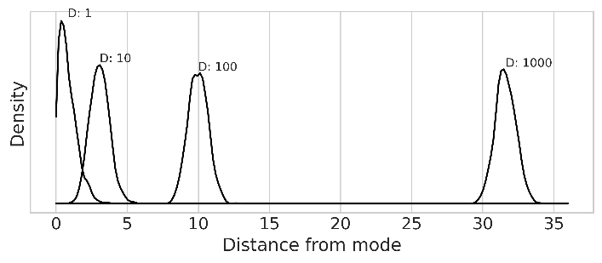
In high dimensions, things are weird
Most of the probability is far from the mode
def rad_dist(Y):
return np.sqrt(np.sum(Y**2))
for D in [1, 10, 100, 1000]:
T = int(1e3)
Y = stats.multivariate_normal(np.zeros(D), np.identity(D)).rvs(T)
Rd = list(map(rad_dist, Y))

Slide 22
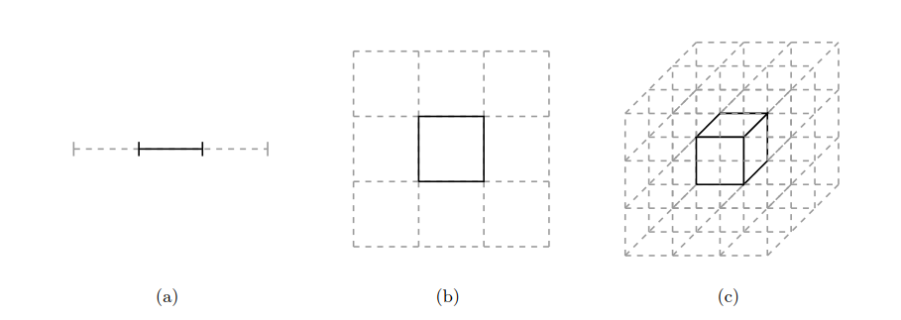
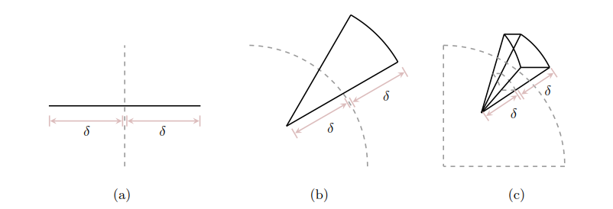
Because most of the space is far from the mode
Consider a N-D cube
What percentage is in the middle?
Consider a spherical shell
Let dimensionality increase
Look at exterior and interior volume

Slide 23
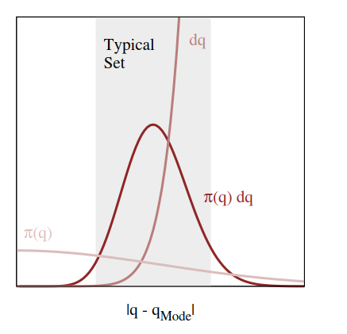

This means expectations are dominated by a “typical set”
Visualization of a typical set in high dimensions

Slide 24

Efficient sampling
Focus on the typical set
No reason to sample where $p\left(θ∣y\right)=0$

Slide 25
5E Quadratic approximations

Slide 26
Sample from something easier
We want to sample from the posterior
Instead, we can sample from an approximation

